Slide 1
Sea Animal Classification

Slide 2
Does it have legs?
Yes
No

Slide 3
Does it ?
Yes
No

Slide 4
Does it ?
Yes
No

Slide 5
Does it ?
Yes
No

Slide 6
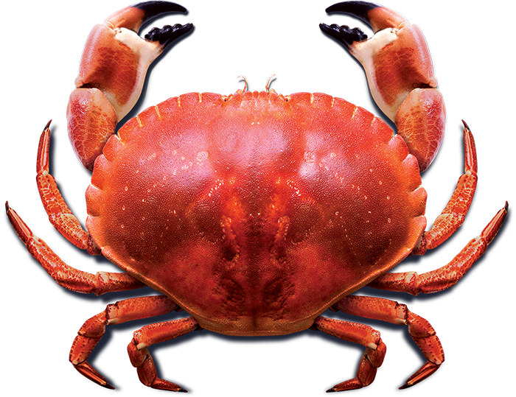
It’s a crab!

Slide 7
Does it have legs?
Yes
No

Slide 8
Does it have legs?
Yes
No

