Slide 2
Diving into Mastery Guidance for Educators
Each activity sheet is split into three sections, diving, deeper and deepest, which are represented by the following icons:
These carefully designed activities take your children through a learning journey, initially ensuring they are fluent with the key concept being taught; then applying this to a range of reasoning and problem-solving activities.
These sheets might not necessarily be used in a linear way. Some children might begin at the ‘Deeper’ section and in fact, others may ‘dive straight in’ to the ‘Deepest’ section if they have already mastered the skill and are applying this to show their depth of understanding.
Diving
Deeper
Deepest

Slide 3
Aim
Solve problems involving converting between units of time.

Slide 4
Timetables
Diving
Use the bus timetable to answer the questions.
How many minutes does it take to travel from the pizza restaurant to the cinema?
Greengate Lane » Hilltop Road
 | Bus 24
Pizza Restaurant | 14:22
DIY Store | 14:35
Supermarket | 14:48
Police Station | 15:05
Cinema | 15:16
Car Park | 15:25
54 minutes
How many seconds does it take to travel from the cinema to the car park?
540 seconds
The bus is delayed for 360 seconds by roadworks. What time does it get to the police station?
15:11

Slide 5
Timetables
Diving
Use the TV guide timetable to answer the questions.
How many minutes is the Tick Tock Music show on for?
15 minutes
How many seconds is the Eyes on the Past History Documentary on for?
1200 seconds
What TV programme is on at four o’clock on channel 23?
Brain Busters Gameshow

Slide 6
Timetables
Deeper
Here is part of a train timetable.
London Euston » Preston
 | A | B | C | D | E
London Euston | 13:00 | 15:30 | 15:45 | 17:30 | 16:45
Rugby | 14:15 | 16:05 | 16:20 | - | 17:20
Birmingham New Street | 15:10 | 17:00 | 17:15 | - | 18:15
It takes 90 minutes to travel from London Euston to Birmingham New Street on train E.
Is Sam correct? Explain your answer.
Sam is correct.
The journey takes 1 hour and 30 minutes (16:45 to 18:15). This is equal to 90 minutes.

Slide 7
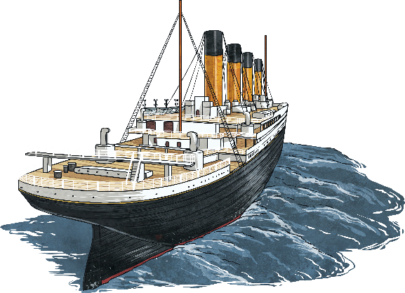
Timetables
Deepest
A ferry service operates every day between two islands. There are six ferries.
Ferries A, C and E start the day on Crystal Island.
Ferries B, D and F start the day on Sandy Island.
It takes 120 minutes for each ferry to complete a round trip between the two islands.
A ferry departs from each island every 15 minutes.
The first ferries of the day leave each island at 07:00.
Complete the ferry service timetable on the next slide for the first trips of the day.

Slide 8
Timetables
Deepest
Ferry Service Timetable
 | A | B | C | D | E | F
Departs Crystal Island
Arrives Sandy Island
Departs Sandy Island
Arrives Crystal Island
07:00
08:00
07:15
08:00
07:30
08:30
08:00
09:00
08:15
09:15
08:30
09:30
08:00
07:00
08:15
07:15
08:30
07:30
09:00
08:00
09:15
08:15
09:30
08:30

Slide 9
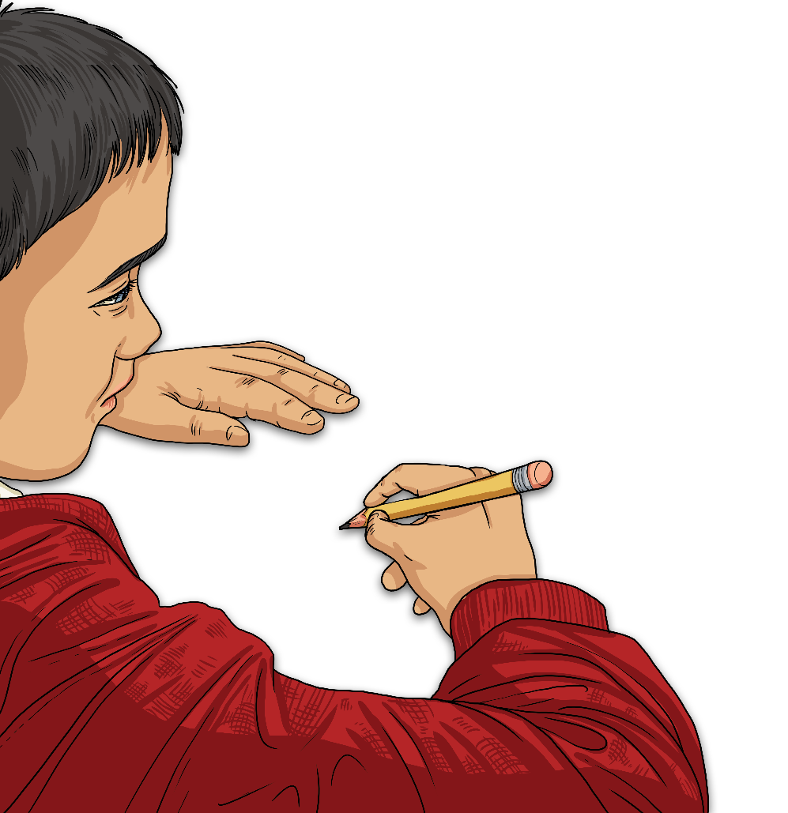
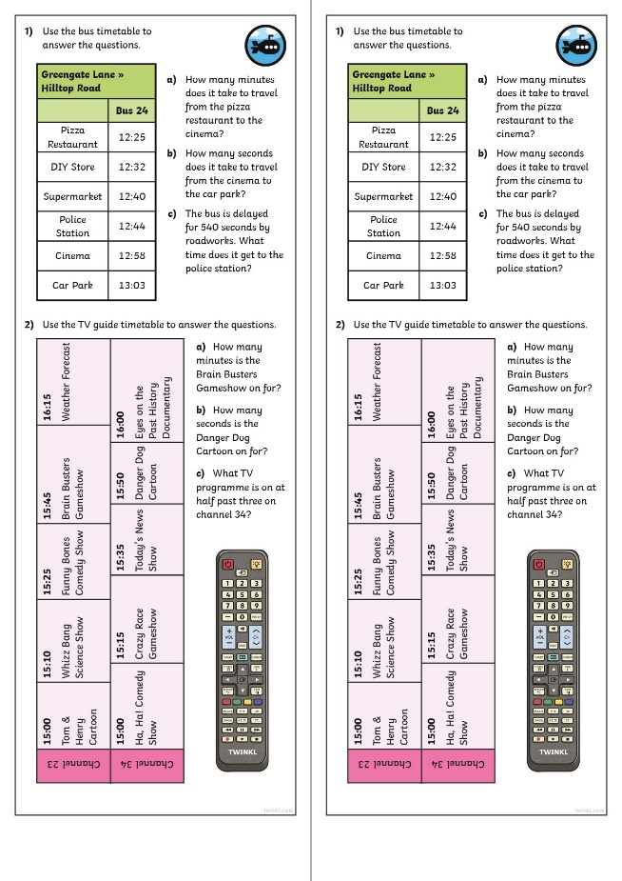
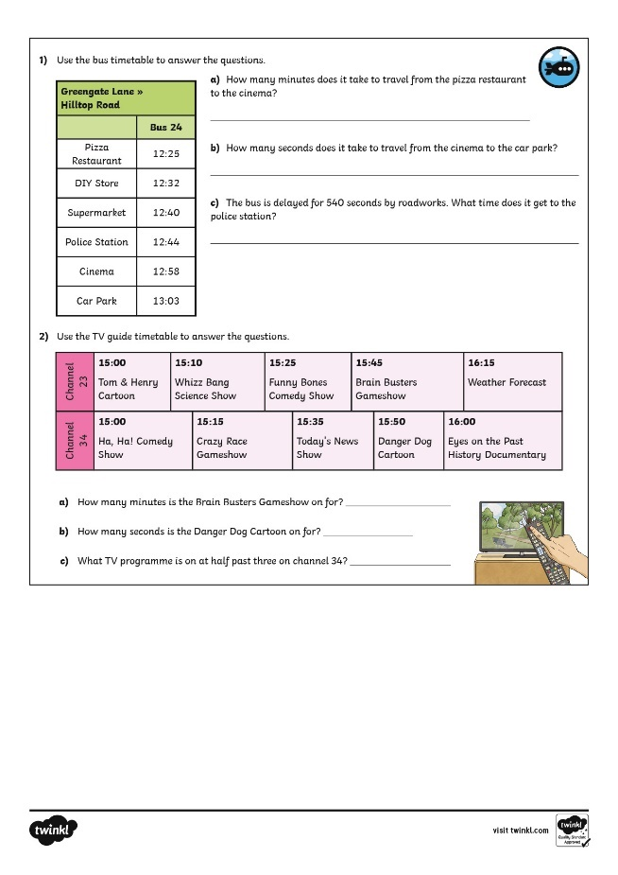
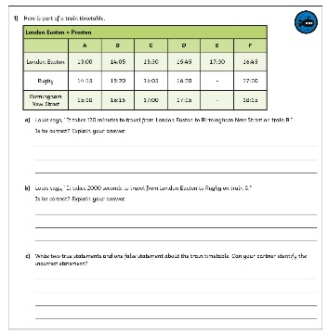
Calculating Angles on a Straight Line
Dive in by completing your own activity!

Slide 10
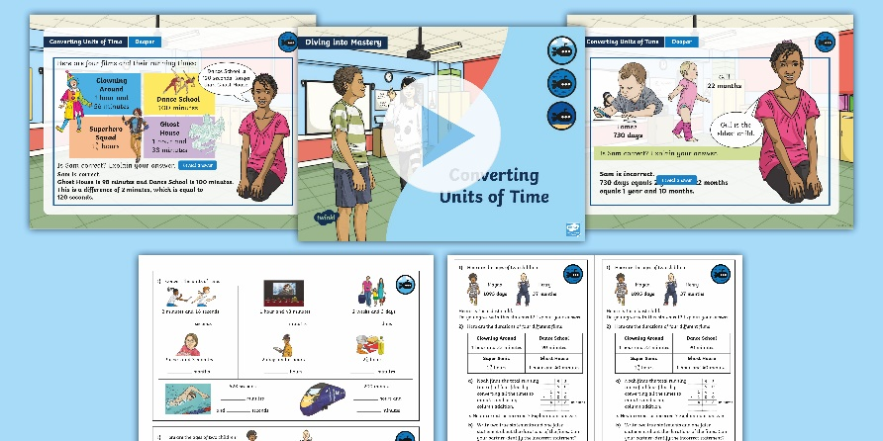
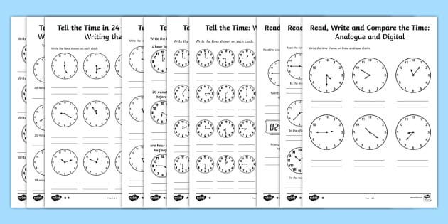
Need Planning to Complement this Resource?
National Curriculum Aim
Solve problems involving converting between units of time.
For more planning resources to support this aim, click here.
Twinkl PlanIt is our award-winning scheme of work with over 4000 resources.

