Slide 2
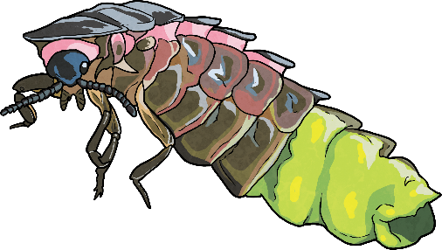
When the Lights Go out
Items that glow in the dark can be mysterious and fascinating.
Did You Know?...
Long before things such as glow sticks came along,
some plants, fungi and animals were glowing in the dark. The production of light by a living organism is known as bioluminescence.

Slide 3
Let There Be Light!
Biologist William Beebe helped discover many marine species in the deep sea that glowed. These organisms had glowing spots in certain helpful places or glowing patterns on their bodies. Some glowing organisms that are found in the water include;
Anglerfish
Crystal jellyfish
Bathocyroe fosteri (jellyfish)
Tomopteris
Moon jellyfish
Atolla jellyfish
Clusterwink snail
Black dragonfish
Other glowing organisms can include certain types of;
Did You Know…
Small invertebrates
Fungi
Flies
Worms
Snails
Motyxia are millipedes that give off a glow that is a teal colour. They use a special type of protein to make light from beneath the tough outer layer of their bodies.

Slide 4
Why?
It is thought that bioluminescence is used by organisms to lure prey, communicate, deal with a build-up of harmful chemicals and protect against predators.
Answers Coming to Light
We still do not know why many organisms use bioluminescence. Research is being done by scientists to discover why some living things want or need to create their own light. They are trying to answer questions like;
Why would a fungi use light?
What use is light to a worm living in the dark soil?
How is the light helpful to the organism creating it and other organisms?
The search is on to find more living things that can create their own light. However, discovering them is a real challenge as they can only be seen in the dark.

Slide 5
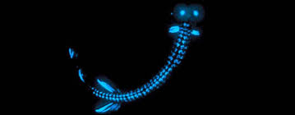
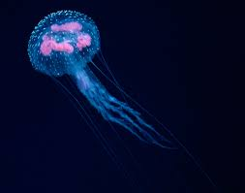
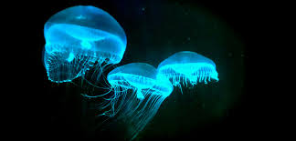
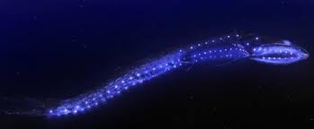
Can you find some examples on the internet of ocean creatures that use this special skill ?

