Slide 1
Maths
Properties of Shapes
Year One
Maths | Year 6 | Properties of Shapes | Angles | Lesson 1 of 4: Angles at a Point

Slide 2
Angles at a Point

Slide 3
Aim
I can recognise angles where they meet at a point and find missing angles.
Success Criteria
I know that angles at a point total 360˚.
I can label angles correctly using capital letters.
I can find missing angles at a point.

Slide 4
Types of Angle
Is the angle shown acute, obtuse or reflex?
Acute
Obtuse
Reflex
Incorrect
Correct
Incorrect

Slide 5
Types of Angle
Is the angle shown acute, obtuse or reflex?
Acute
Obtuse
Reflex
Incorrect
Incorrect
Correct

Slide 6
Types of Angle
Is the angle shown acute, obtuse or reflex?
Acute
Obtuse
Reflex
Correct
Incorrect
Incorrect

Slide 7
Types of Angle
Is the angle shown acute, obtuse or reflex?
Acute
Obtuse
Reflex
Incorrect
Incorrect
Correct

Slide 8
Types of Angle
Is the angle shown acute, obtuse or reflex?
Acute
Obtuse
Reflex
Correct
Incorrect
Incorrect

Slide 9
Types of Angle
Is the angle shown acute, obtuse or reflex?
Acute
Obtuse
Reflex
Incorrect
Correct
Incorrect

Slide 10
Angles at a Point
An angle is created when two straight lines meet at a point.
95˚
Angles at a point total 360°.
265˚
An angle is the measure of rotation from one line to the other either clockwise or anticlockwise.

Slide 11
360˚ Angles
Work with your partner to match angle pairs which total 360° around a point.

Slide 12
360˚ Angles
Did you find the pairs of angles that total 360° around a point?
210˚
150˚
90˚
270˚
100˚
45˚
315˚
260˚

Slide 13
Labelling Angles
A
Label an angle using three uppercase, consecutive letters. The first and third letters indicate the two lines (arms) of the angle, and the middle letter indicates the point (vertex).
70˚
To refer to an angle we use the symbol ∠ and the letter of the vertex, or the three letters with the vertex letter in the middle.
B
C
∠ B = 70°
or
∠ ABC = 70°

Slide 14
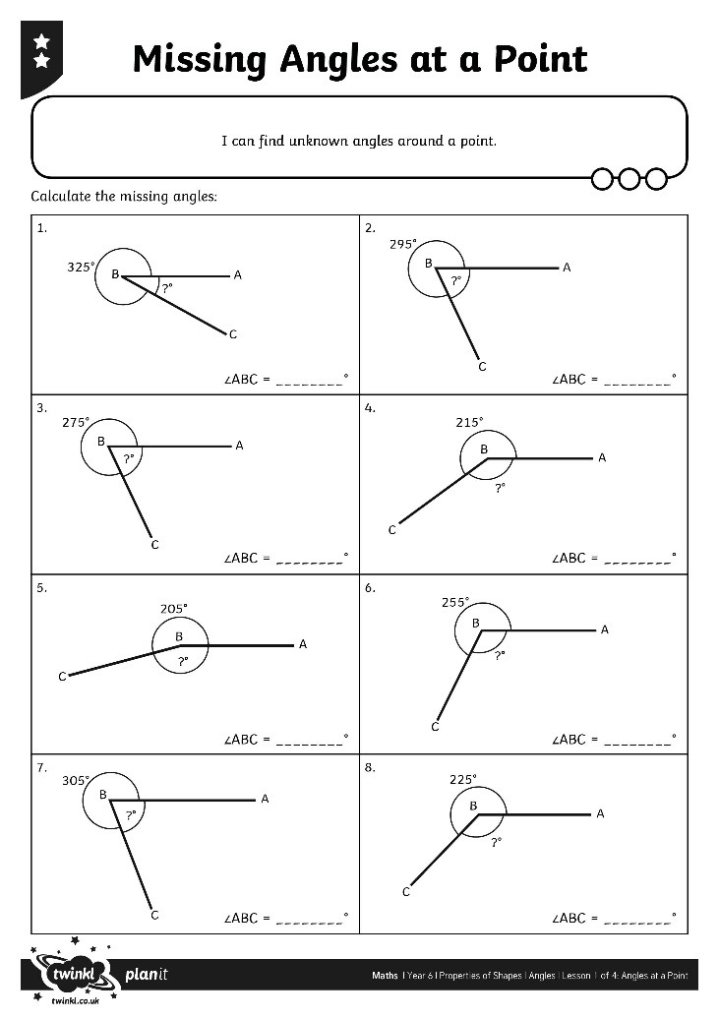
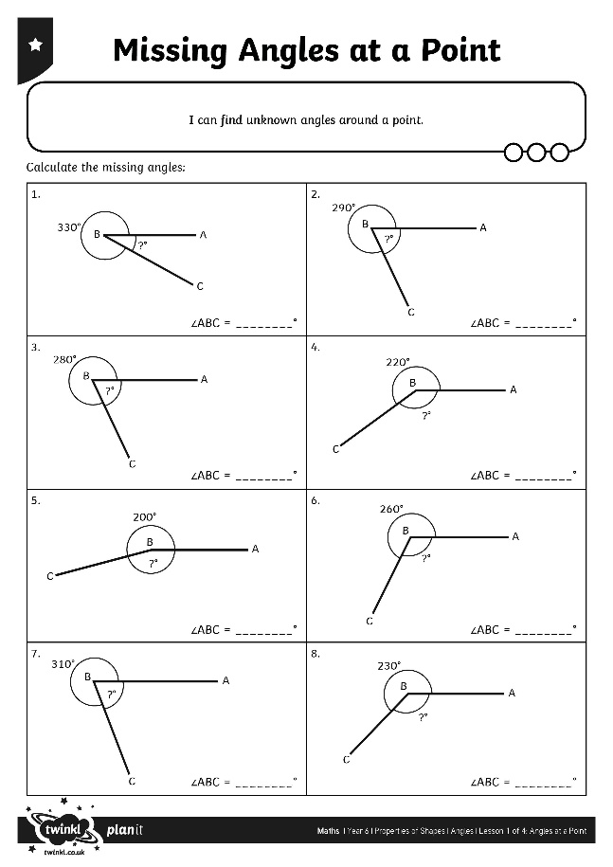
Missing Angles at a Point

Slide 15
True or False Angle Calculations
A
C
B
305˚
∠ABC = 55°
True
False

Slide 16
True or False Angle Calculations
X
Z
Y
220˚
∠XYZ = 145°
True
False

Slide 17
True or False Angle Calculations
L
M
280˚
N
∠NML = 145°
True
False

Slide 18
Aim
I can recognise angles where they meet at a point and find missing angles.
Success Criteria
I know that angles at a point total 360˚.
I can label angles correctly using capital letters.
I can find missing angles at a point.

